Slide 1
Input Actions & Methods
Every time we insert data into an application, or we send a command to a system to produce a change (or a continuation), we perform an input action. In UiPath, the main input actions are Click, Type into, Send Hotkey and Hover. These are also the main actions that a human user would perform to input data in an application.
Input Methods
Default
Send Window Messages
Simulate

Slide 2
Default Methods
How does it work?
Clicks: the mouse cursor moves across the screen
Typing: the keyboard driver is used to type individual characters
What are the implications?
Attended User cannot touch the mouse or keyboard during the automation
It has a lower speed and load times can impact accuracy
What are the strong points?
Supports special keys like Enter, Tab, and other hotkeys
100% compatibility
What are the limitations?
Does not automatically erase previously written text
Does not work in the background

Slide 3
Send Window Messages Method
How does it work?
Replays the window messages that the target application receives when the mouse/keyboard is used
Clicking and typing occur instantly
What are the implications?
Works in the background
Comparable to the Default method in terms of speed
What are the strong points?
Supports special keys like Enter, Tab, and other hotkeys
Users can work on other activities during the execution of the automated processes
What are the limitations?
Does not automatically erase previously written text
Works only with applications that respond to Window Messages

Slide 4
Simulate Method
How does it work?
Uses the technology of the target application (the API level) to send instructions
Clicking and typing occur instantly
What are the implications?
Works in the background
Actions are a lot faster, but there are some compatibility limitations
What are the strong points?
Can automatically erase previously written text
Users can work on other activities during the execution of the automated processes
What are the limitations?
Does not support special keys like Enter, Tab, and other hotkeys
It has a lower compatibility than the other 2 methods

Slide 5
Input Actions
Click, Type into and Send hotkey are simple in terms of what they primarily do. All the input actions share several properties:
Delay: can be used to set a delay before or after the click;
WaitForReady: can be configured to wait for the target to become ready by verifying certain application tags.
Click
ClickType: can be single or double (changing the default to double makes it very similar to a separate activity – Double Click);
MouseButton: can be configured to left, middle or right button; Timeout: specifies the duration in which the activity is retried until an error is thrown,
KeyModifiers: can press the Alt, Ctrl, Shift and/or the Win key while performing the action.

Slide 6
Input Actions
Type into
Activate: the field in which the text is typed is brought to the foreground and activated, before the typing;
ClickBeforeTyping: the UI element in which the text will be typed into will be clicked on before typing;
DelayBetweenKeys: the delay between each key is typed;
EmptyField: the UI element will be emptied before typing
For typing into protected fields, such as ‘Password’, there is a more suitable activity – Type Secure Text.
Send hotkey
Activate: the field in which the text is typed is brought to the foreground and activated, before the typing;
ClickBeforeTyping: the UI element in which the text will be typed into will be clicked on before typing;
DelayBetweenKeys: the delay between each key is typed;
EmptyField: the UI element will be emptied before typing.

Slide 7
Output Actions & Methods
Output actions are used in UiPath either to extract data (in general, as text) from a UI element. Output methods are what enables output actions to extract data from UI elements. Let's discuss these first.
Output Methods
FullText
Native
OCR

Slide 8
Output Methods
Full Text -The FullText method is the default method and good enough in most cases. It is the fastest, it has 100% accuracy and can work in the background. Moreover, it can extract hidden text (for example, the options in a drop-down list). On the other hand, it doesn’t support virtual environments and it doesn’t capture text position and formatting. This method offers the option to ignore the hidden message and capture only the visible text.
Native -The Native method is compatible with applications that use Graphics Design Interface (GDI), the Microsoft API used for representing graphical objects. It can extract the text position and formatting (including text color) and has 100% accuracy on the applications that support GDI. Its speed is somewhat lower than FullText, it doesn’t extract hidden text and it cannot work in the background; and just like FullText, it doesn’t support virtual environments.By default, it can process all known characters as separators (comma, space, and so on), but when only certain separators are specified, it can ignore all the others
OCR -OCR (or Optical Character Recognition) is the only output method that works with virtual environments and with “reading” text from images. Its technology relies on recognizing each character and its position. On the other hand, it cannot work in the background, it cannot extract hidden text, and its speed is by far the lowest. Its accuracy varies from one text to another and changing settings can also improve the results. Just like the Native method, it also captures the text position.

Slide 9
Output Actions
Get Text Activity - Extracts a text value from a specified UI element.
Get Full Text Activity -Extracts a string and its information from an indicated UI element using the FullText screen scraping method.
Get Visible Text Activity-Extracts a string and its information from an indicated UI element using the Native screen scraping method.
Get OCR Text Activity-Extracts a string and its information from an indicated UI element using the OCR screen scraping method. This activity can also be automatically generated when performing screen scraping, along with a container.
Data Scraping Wizard -Data scraping is a functionality of UiPath Studio that allows the extraction of structured information from an application, browser or document to a DataTable variable.

Slide 10
Working with UI Elements
Input and Output Actions can be viewed as a succession of 2 micro-steps: first, recognizing UI elements, and then inputting (or extracting) data. In many cases, such as most of the examples that we covered in the previous chapters, the first step is easily sorted out either by including it in the activity, or by using the delay option. This is why, in many cases, it’s not at all necessary to have a separate activity for locating an UI element (like a Find Element activity) before an actual Click or Type activity.

Slide 11
UI Activities
Find Element - Waits for the specified UI element to appear on the screen (to be in the foreground) and returns it as a UiElement variable. This is useful, for example, when a certain action needs to be performed on the Ui Element found.
Element Exists- Enables you to verify if a UI element exists, even if it is not visible. It returns a Boolean variable, which makes it very useful in ‘If statement’ activities, for example.
Wait Element Vanish – Waits for the specified UI element to disappear from the screen. It’s an alternative to Find Element, for example when the disappearance of an element (a loading sign) is more reliable then the appearance of another element.
On Element Appear- A container that waits for a UI element to appear and enables you to perform multiple actions within it.
On Element Vanish-A container that enables you to perform one or multiple actions after a specified UI element vanishes.
Text Exists -Checks if a text is found in a given UI element. There’s an alternative version of this that uses OCR technology to check for a given UI element. This is useful when UI elements are not accessible otherwise than as images.

Slide 12
Practice 1 - Input Actions & Methods
Input data into Notepad
Create a sequence that does the following Notepad automation:
Asks the user for the text to be typed.
Asks the user for the title under which the file should be saved.
Opens Notepad.
Types the user’s text.
Changes the font style to bold and its size to 16.
Navigates to Save as to save the file with the user’s title.

Slide 13
Practice 2 - Output Actions & Methods
Finding the weather using Google
Create a robot which finds the weather of a specific city using Google. The city of interest is introduced by user.

Slide 14
Practice 3 - Data Scraping & UI Elements
Extracting data from ACME
Create a process that automates extracting the data from ACME catalog page.
Opens the IE browser on page
Use Data scrape wizards to extract the title and the description from the components from all the pages
Save the extracted data into a CSV file
Close browser

Slide 15
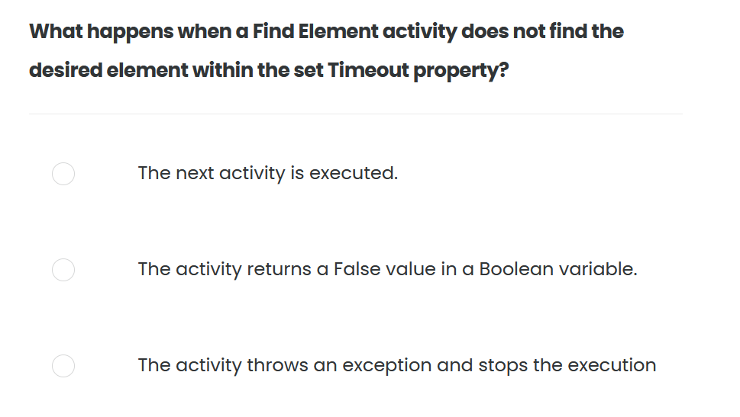
Quiz 01/10

Slide 16
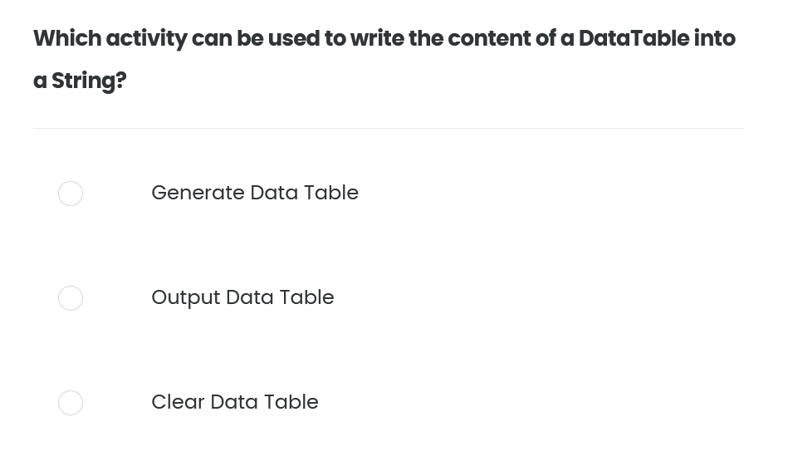
Quiz 02/10

Slide 17
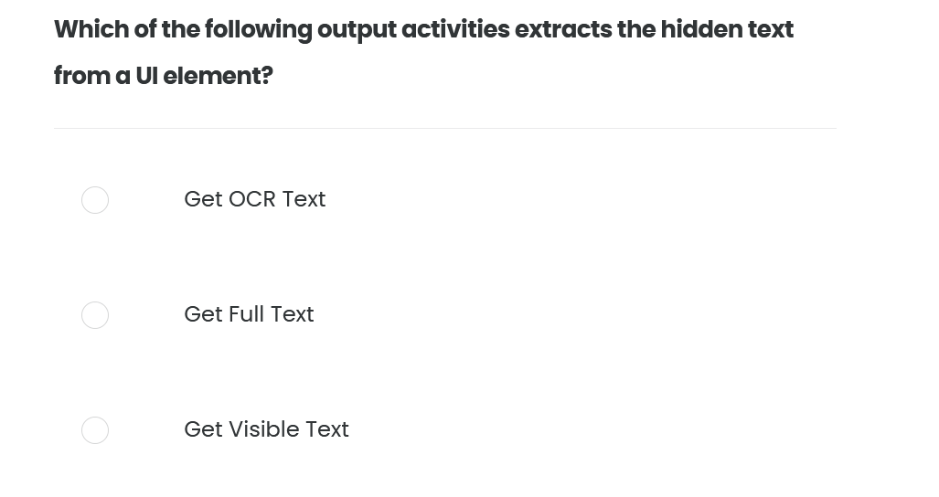
Quiz 03/10

Slide 18
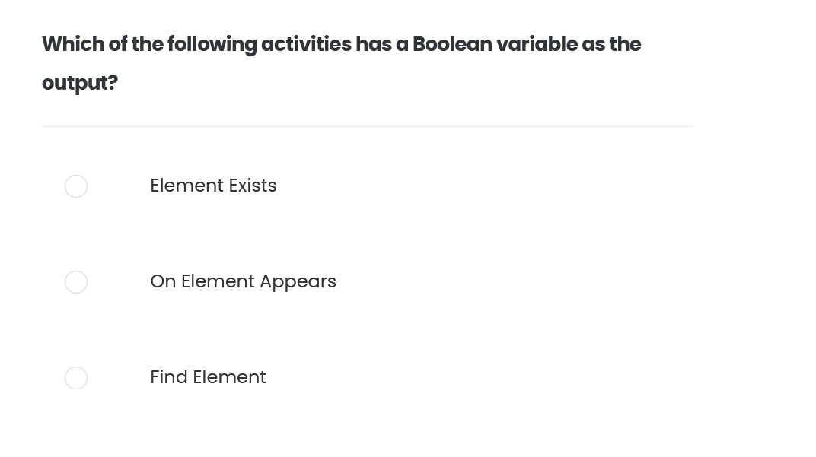
Quiz 04/10

Slide 19
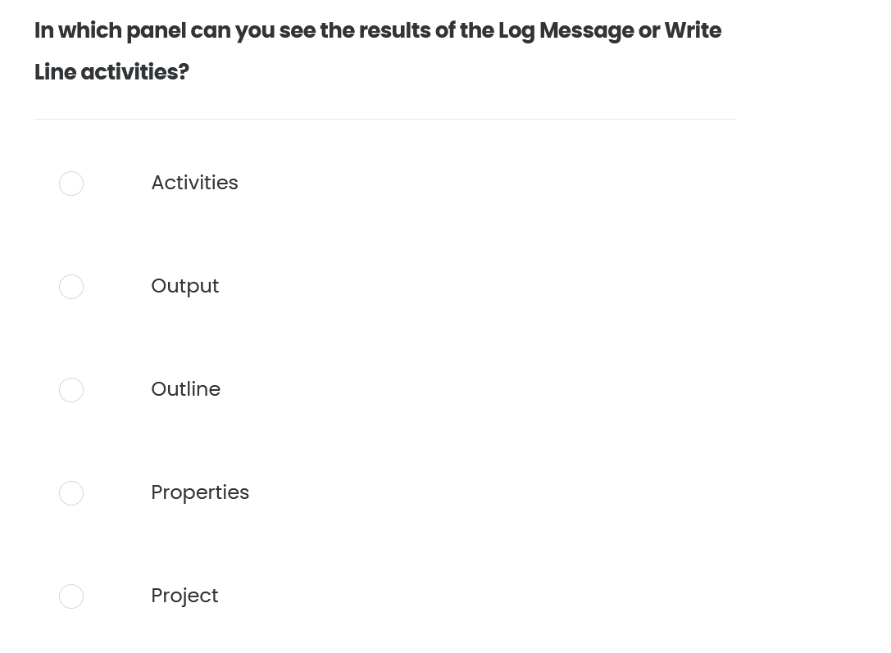
Quiz 05/10

Slide 20
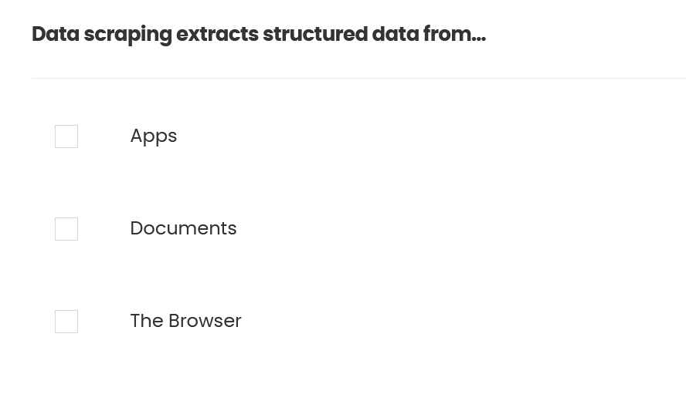
Quiz 06/10

Slide 21
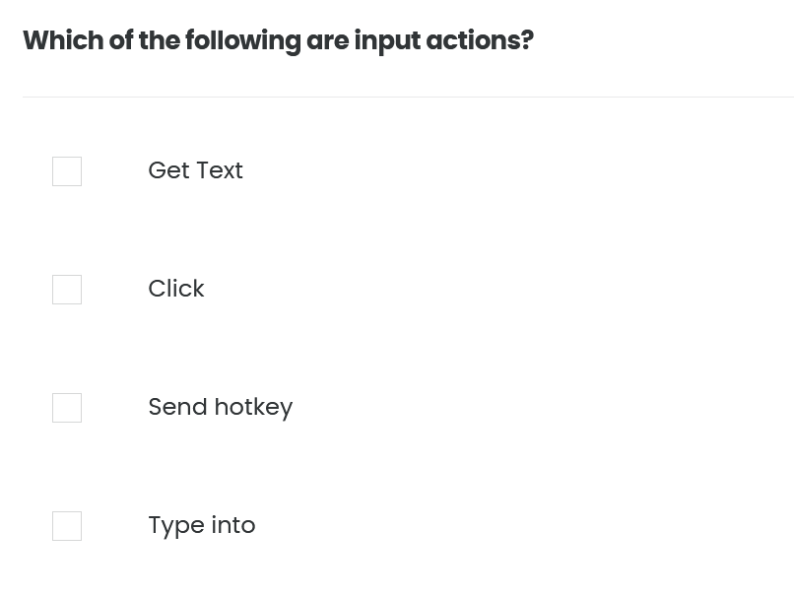
Quiz 07/10

Slide 22
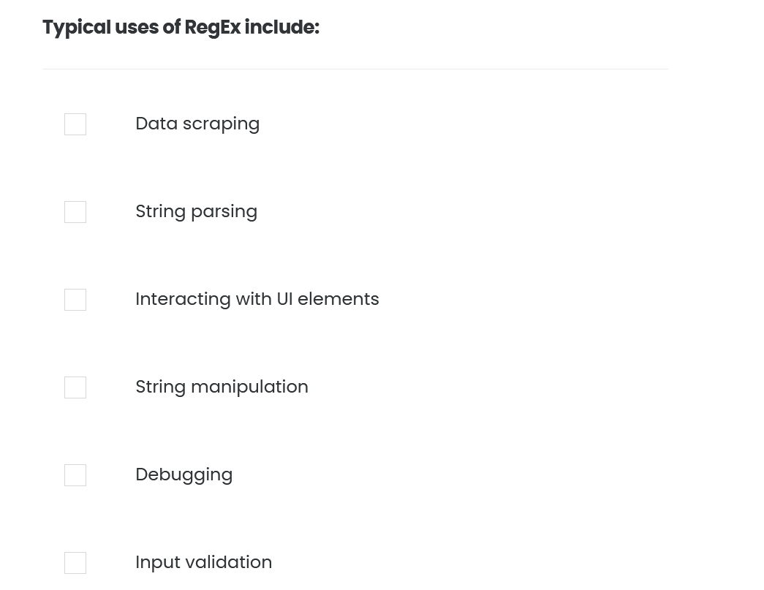
Quiz 08/10

Slide 23
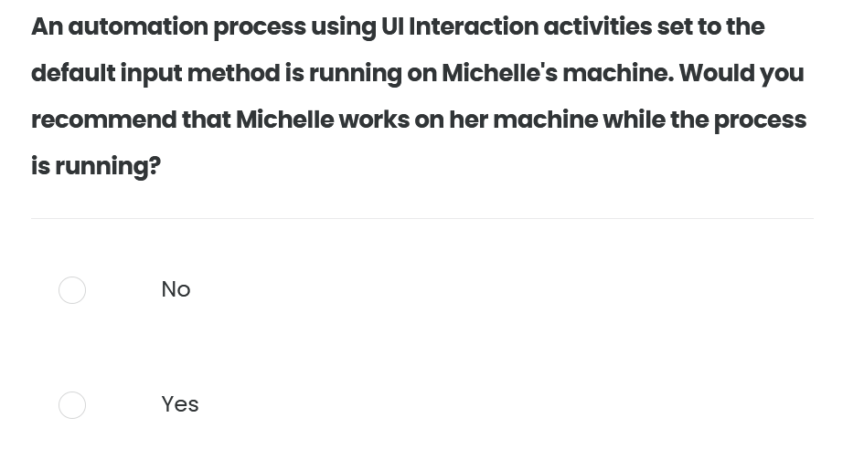
Quiz 09/10

Slide 24
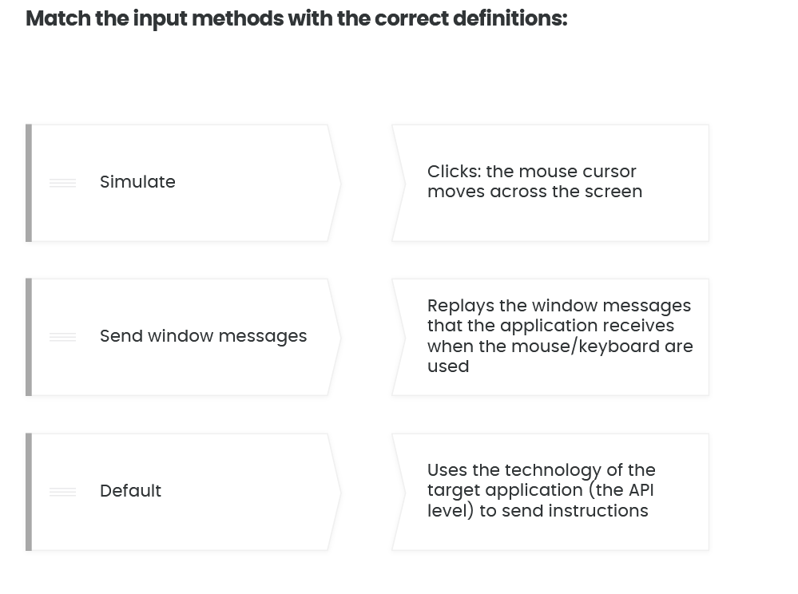
Quiz 10/10

